Slide 1


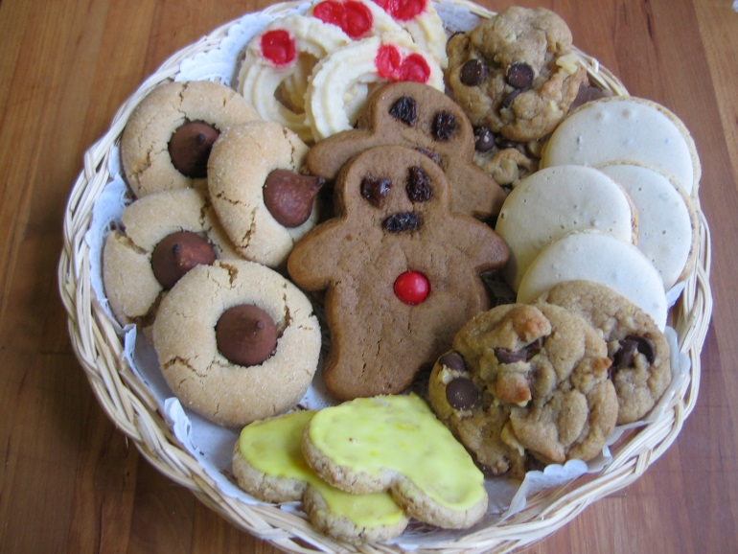
Why is Mr Morgan overweight?
Mr Morgan likes to eat cookies.
If He eats 4 before school and then eats 2 every hour after school starts.
Notes:
hook

Slide 2

Why is Mr Morgan overweight?
Create a linear equation to show how many cookies Mr Morgan eats in a day.
(let y= the number of cookies and x = the time in hours)
y= 2x + 4

Slide 3
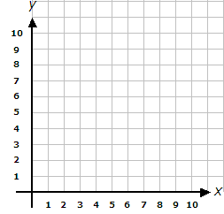


Graphing it looks like this
No wonder he is so fat!

Slide 4
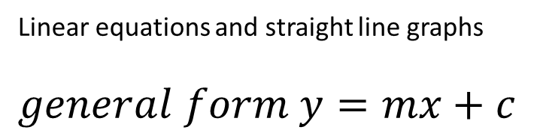
24
7
30
Date
Linear graphs
EQ – How can we graph lines using the gradient intercept method?
Linear equations and straight line graphs
$general form y=mx+c$
Gradient (m) is the slope or steepness of the graph
The Y-intercept (c) is where x= 0 (where the line crosses the y-axis
5
Notes:
Lesson objective (EQ)

Slide 5

24
7
30
Date
Linear graphs
EQ – How can we graph lines using the gradient intercept method?
$y=mx+c$
Gradient y-int
5

Slide 6
Using Gradient and y-intercept
Example: Plot y= 3x + 2 using gradient and y-intercept
Step 1: Read off m = 3 and c = 2
Step 2: Plot y intercept at 2

Slide 7
•

Slide 8

Gradient and y-intercept
(continued)
We’re plotting y=3x + 2 using gradient and y-intercept
Rise is 2
$$m=\frac{3}{1}$$
Run is 1
Step 3: Plot your 2nd point where you use the the gradient.
Step 4: draw the line

Slide 9
Run= 1
Y=3x+2
Rise= 3

Slide 10


Practice
Graph the following lines
y= 2x+1
y= -3x
y= x – 2
y= 3
y= -2x – 5
y= $\frac{3}{4}x+1$
$y=\frac{5}{4}x−3$
$2y+4x=8$
Make sure you;
Label your graphs
Draw 4 per Cartesian plane

Slide 11
Quick questions to finish
What are the gradients and yint of
y=4x+2
y=3x-1
3y= 9x+15
Notes:
Closure

Slide 12
Quick questions to finish
Solutions
What are the gradients and yint of
y=4x+2
m= 4, yint= 2
y=3x-1
m= 3 , yint= -1
3y= 9x+15
m= 3, yint= 5
Notes:
Closure

